Slide 1


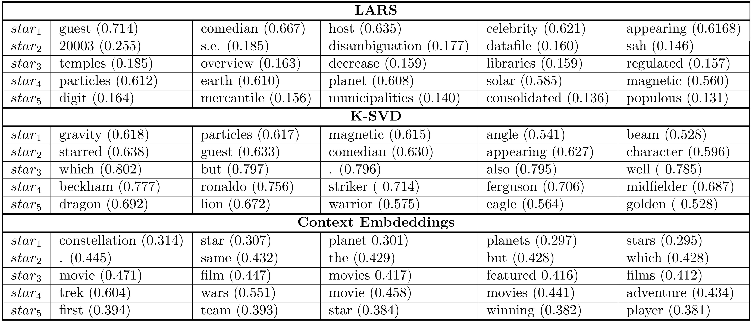
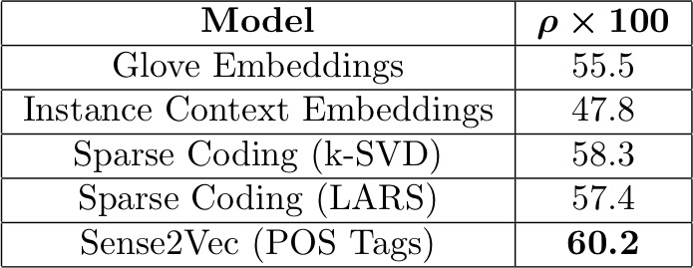
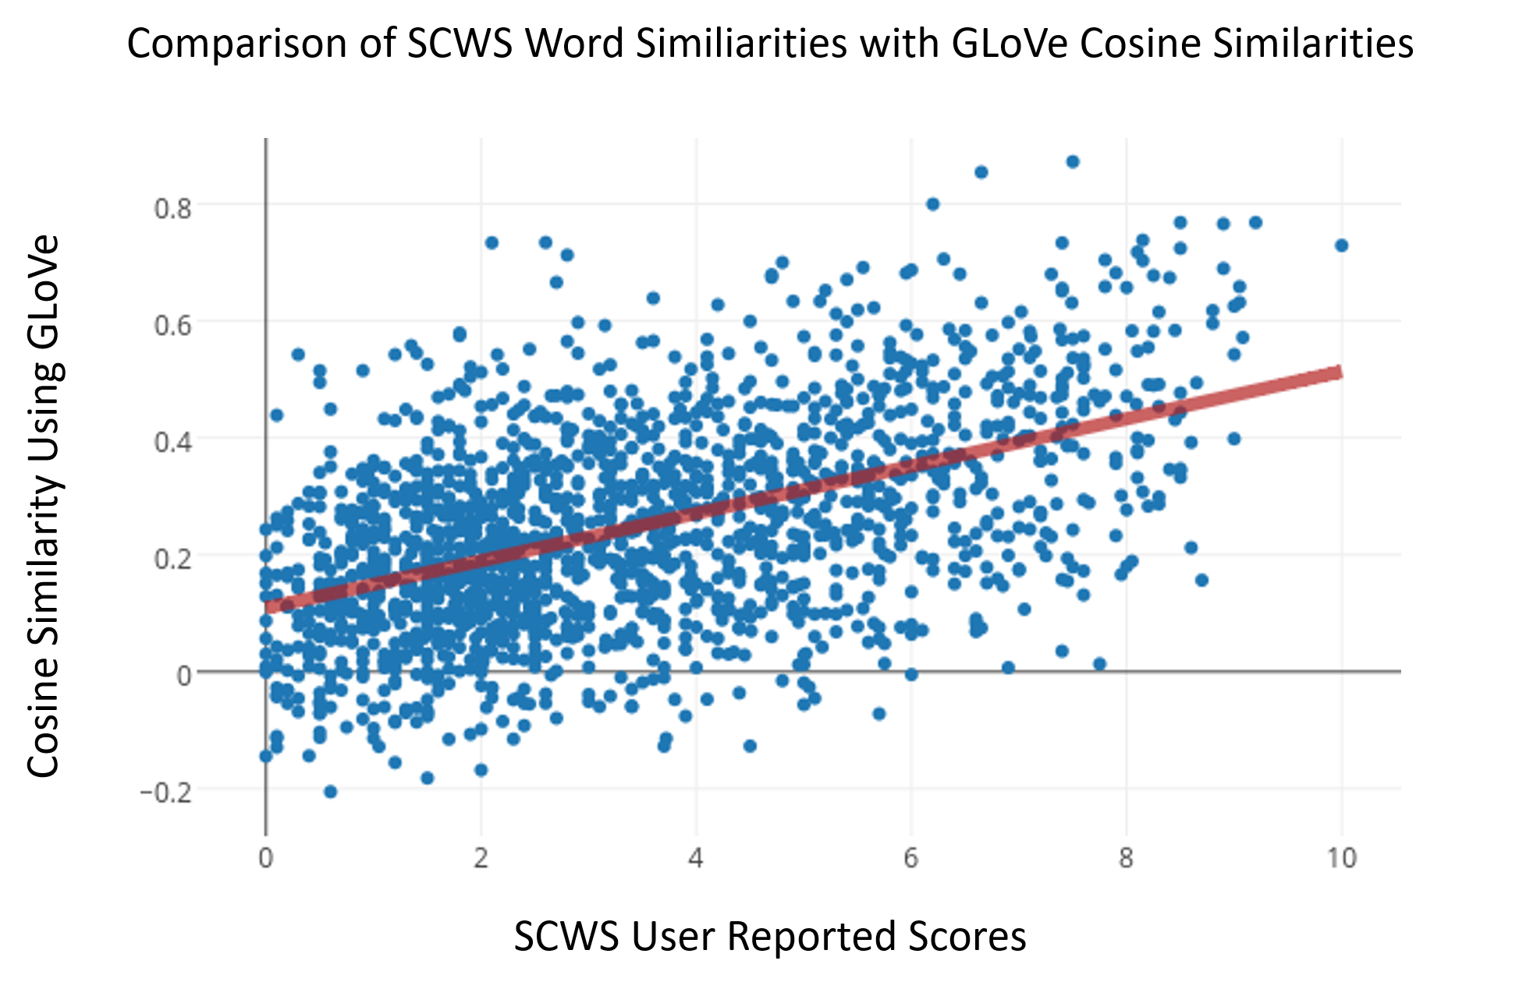
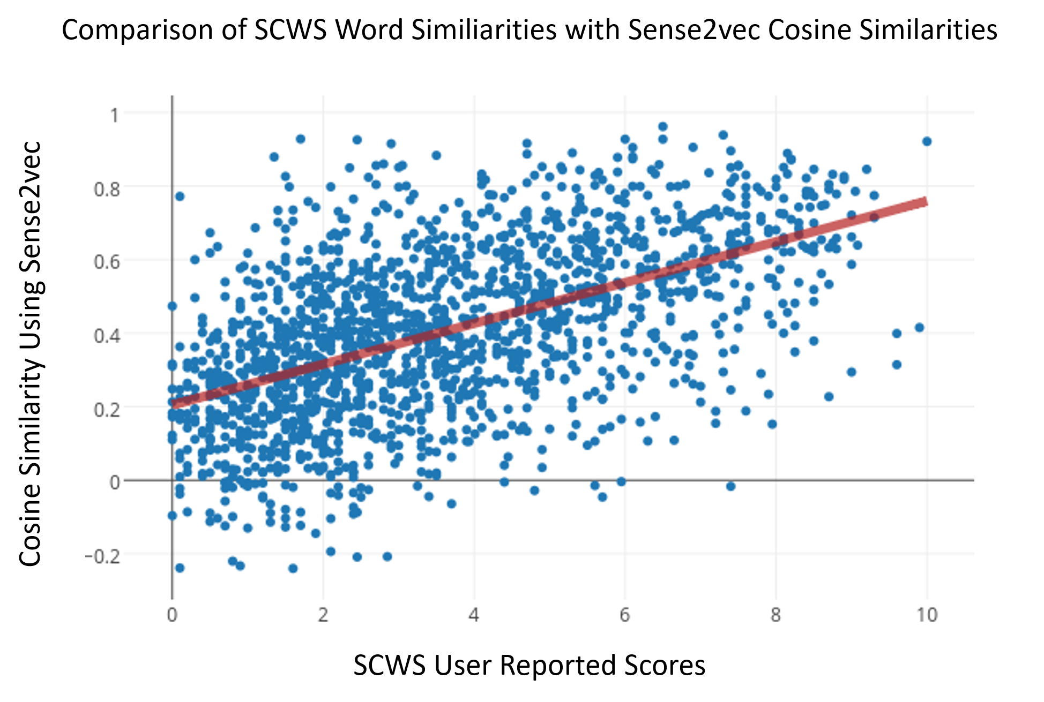
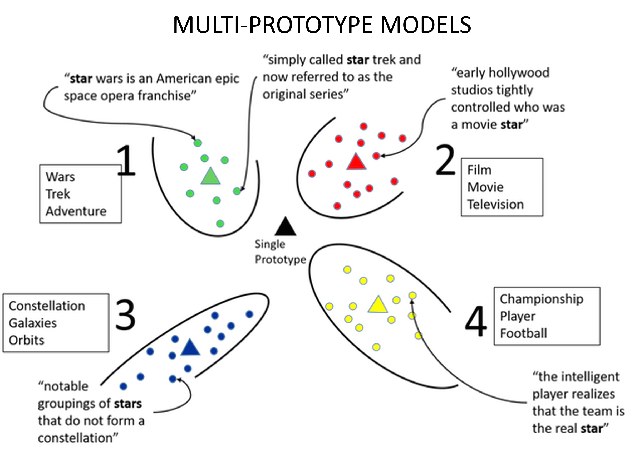
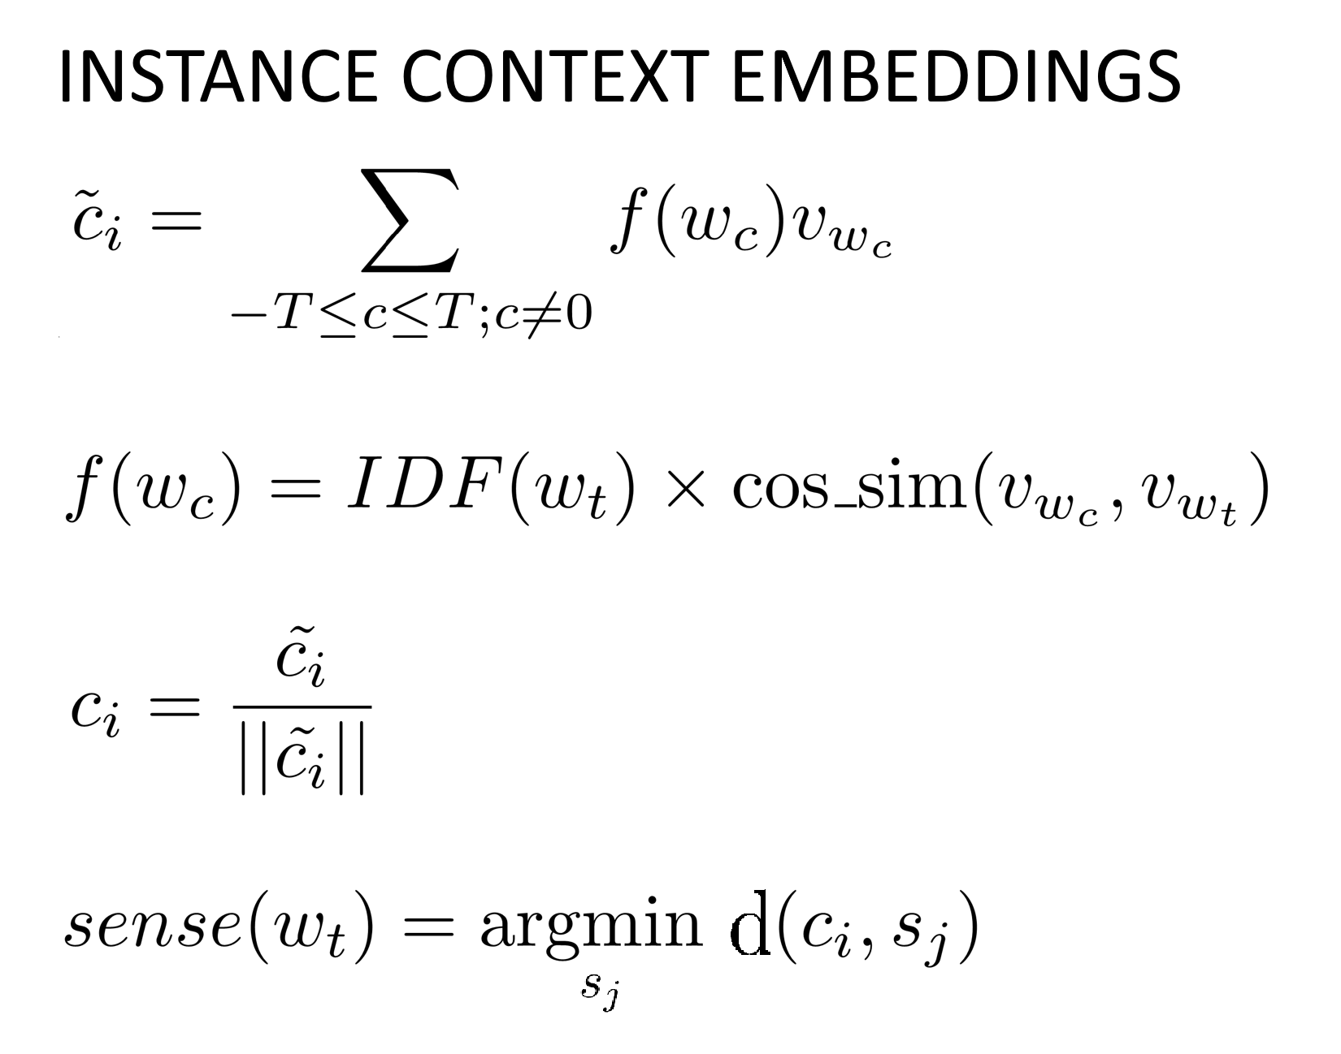
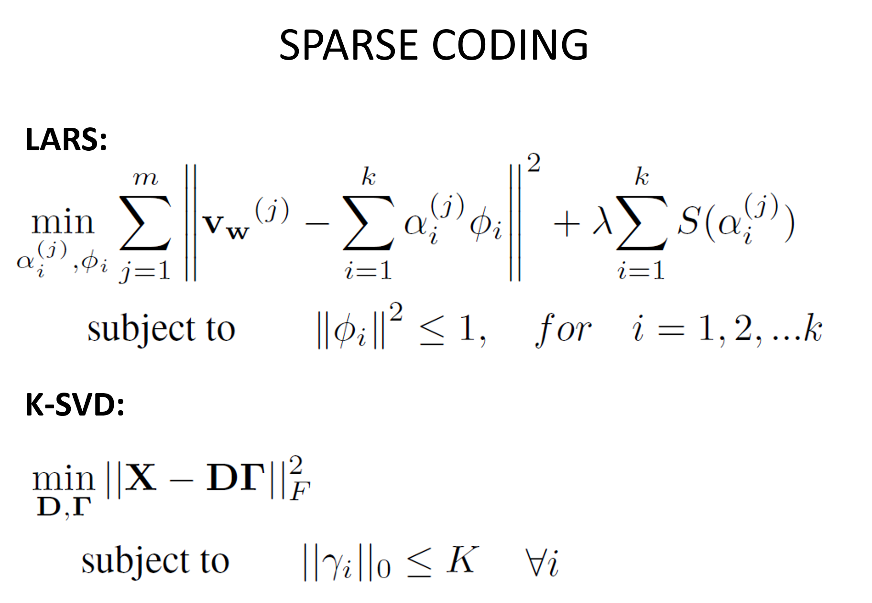
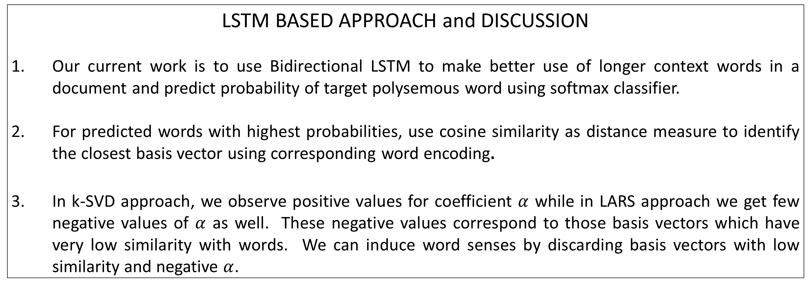
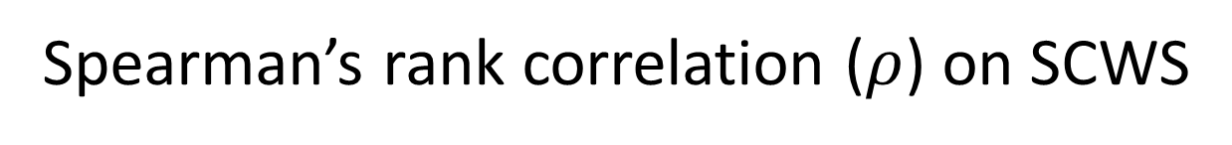
Extracting sense vectors from word embeddings
Devendra Sachan, Easwaran Ramamurthy, Tejus Siddagangaiah
ABSTRACT
Vector Space Models (VSMs) represent words as dense, real-valued vectors in an embedding space where semantically and syntactically similar words are closer to each other. However, one notable deficiency in these methods is that they cannot capture multiple senses of each word, thereby ignoring polysemes and homonyms. Our work focuses on a comparative study and evaluation of existing methods on SCWS dataset which contains human rated similarity between pairs of words. We perform qualitative evaluation of Wikipedia and GLoVe vectors using nearest neighbor search after clustering context embeddings. We also obtain good results on sense induction by applying LARS algorithm for sparse coding. Currently we are working on learning better context representations for polysemous words using Bidirectional LSTM followed by using sense vectors for its most probable predictions.
Nearest Neighbor Visualizations on Wikipedia Dataset for five senses of the word “star”
Spearman’s rank correlation ($ρ$) on SCWS
LSTM BASED APPROACH and DISCUSSION
Our current work is to use Bidirectional LSTM to make better use of longer context words in a document and predict probability of target polysemous word using softmax classifier.
For predicted words with highest probabilities, use cosine similarity as distance measure to identify the closest basis vector using corresponding word encoding.
In k-SVD approach, we observe positive values for coefficient $α$ while in LARS approach we get few negative values of $α$ as well. These negative values correspond to those basis vectors which have very low similarity with words. We can induce word senses by discarding basis vectors with low similarity and negative $α$.
REFERENCES
Sanjeev Arora, Yuanzhi Li, Yingyu Liang, Tengyu Ma, and Andrej Risteski. Linear algebraic structure of word senses, with applications to polysemy. arXiv preprint arXiv:1601.03764,2016.
Andrew Trask, Phil Michalak, and John Liu. sense2vec-a fast and accurate method for word sense disambiguation in neural word embeddings. arXiv preprint arXiv:1511.06388, 2015.
Huang, E. H., Socher, R., Manning, C. D., and Ng, A. Y. (2012, July). Improving word representations via global context and multiple word prototypes. In Proceedings of the 50th Annual Meeting of the Association for Computational Linguistics: Long Papers-Volume (pp. 873-882). Association for Computational Linguistics.

